Slide 1
COMP 2230
Week 14 - Friday

Slide 2
Last time
Context-free languages
Pushdown automata
Chomsky's hierarchy of grammars
Halting Problem

Slide 3
Questions?

Slide 4
Assignment 6

Slide 5
Final exam
Final exam:
Wednesday, April 29, 2026
8:00 to 10:00 a.m.
50% longer than previous exams, but you'll have 100% more time
There will be short answer, diagrams, and proofs
It will be comprehensive but weighted toward the last quarter of the course

Slide 6
Propositional Logic Review

Slide 7
Propositional logic
Statements
AND, OR, NOT, IMPLIES
Truth tables
Logical equivalence
De Morgan's laws
Tautologies and contradictions

Slide 8
Laws of Boolean algebra
Name | Law | Dual
Commutative | p ∧ q ≡ q ∧ p | p ∨ q ≡ q ∨ p
Associative | (p ∧ q) ∧ r ≡ p ∧ (q ∧ r) | (p ∨ q) ∨ r ≡ p ∨ (q ∨ r)
Distributive | p ∧ (q ∨ r) ≡ (p ∧ q) ∨ (p ∧ r) | p ∨ (q ∧ r) ≡ (p ∨ q) ∧ (p ∨ r)
Identity | p ∧ t ≡ p | p ∨ c ≡ p
Negation | p ∨ ~p ≡ t | p ∧ ~p ≡ c
Double Negative | ~(~p) ≡ p
Idempotent | p ∧ p ≡ p | p ∨ p ≡ p
Universal Bound | p ∨ t ≡ t | p ∧ c ≡ c
De Morgan's | ~(p ∧ q) ≡ ~p ∨ ~q | ~(p ∨ q) ≡ ~p ∧ ~q
Absorption | p ∨ (p ∧ q) ≡ p | p ∧ (p ∨ q) ≡ p
Negations of t and c | ~t ≡ c | ~c ≡ t

Slide 9
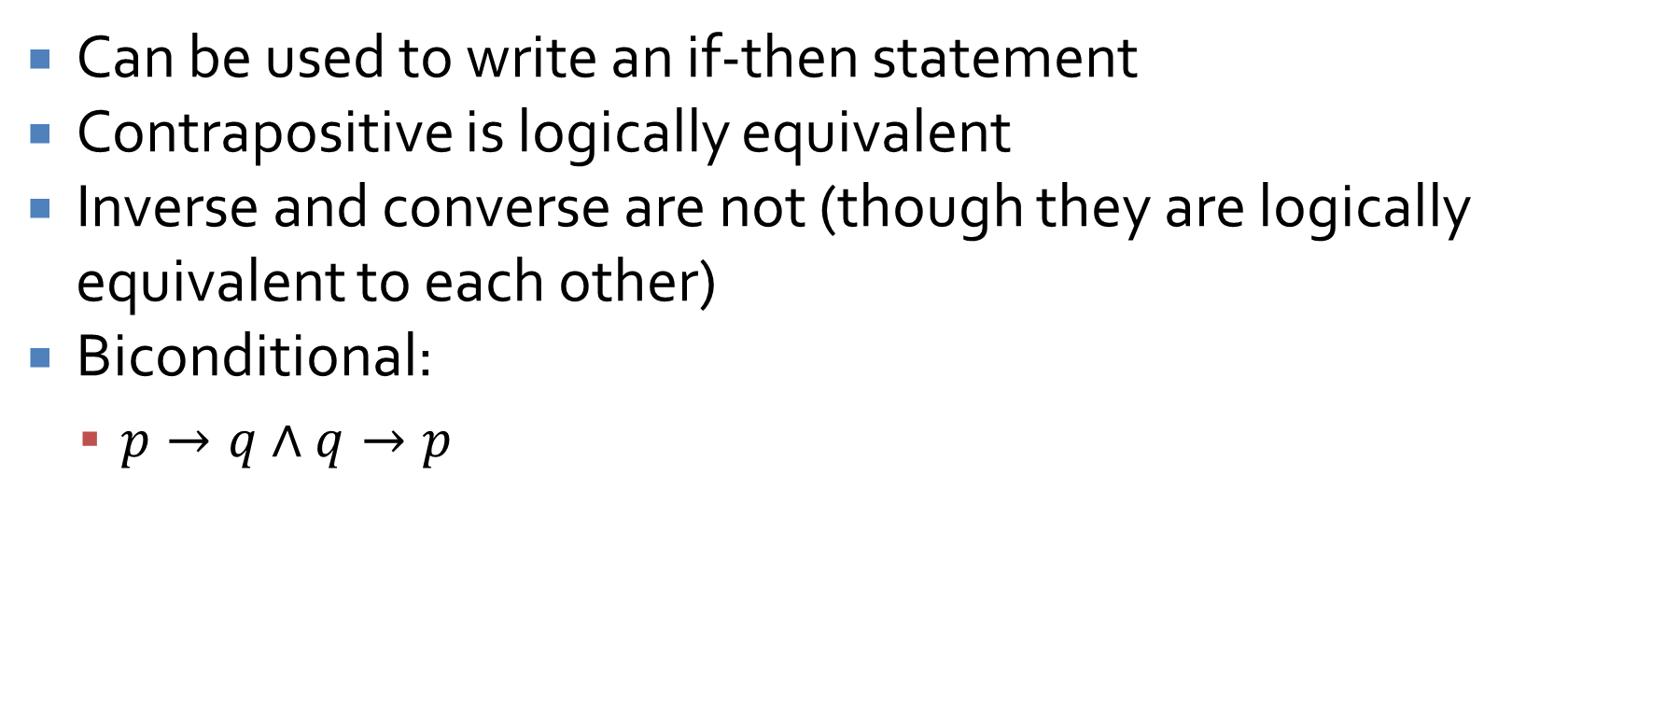
Implications
Can be used to write an if-then statement
Contrapositive is logically equivalent
Inverse and converse are not (though they are logically equivalent to each other)
Biconditional:
$p→q∧q→p$

Slide 10
Arguments
A series of premises and a conclusion
Using the premises and rules of inference, an argument is valid if and only if you can show the conclusion
Rules of inference:
Modus Ponens
Modus Tollens
Generalization
Specialization
Conjunction
Elimination
Transitivity
Division into cases
Contradiction rule

Slide 11

Practice
Show that the following is a valid argument
$\sim p∨q→r$
$s ∨ \sim q$
$\sim t$
$p→t$
$\sim p∧r→\sim s$
$$∴ \sim q$$

Slide 12

Practice
Make a truth table for:
$\sim \left(q→r\right)∨(s∧p) ↔ (p∨r)$

Slide 13
Predicate Logic Review

Slide 14
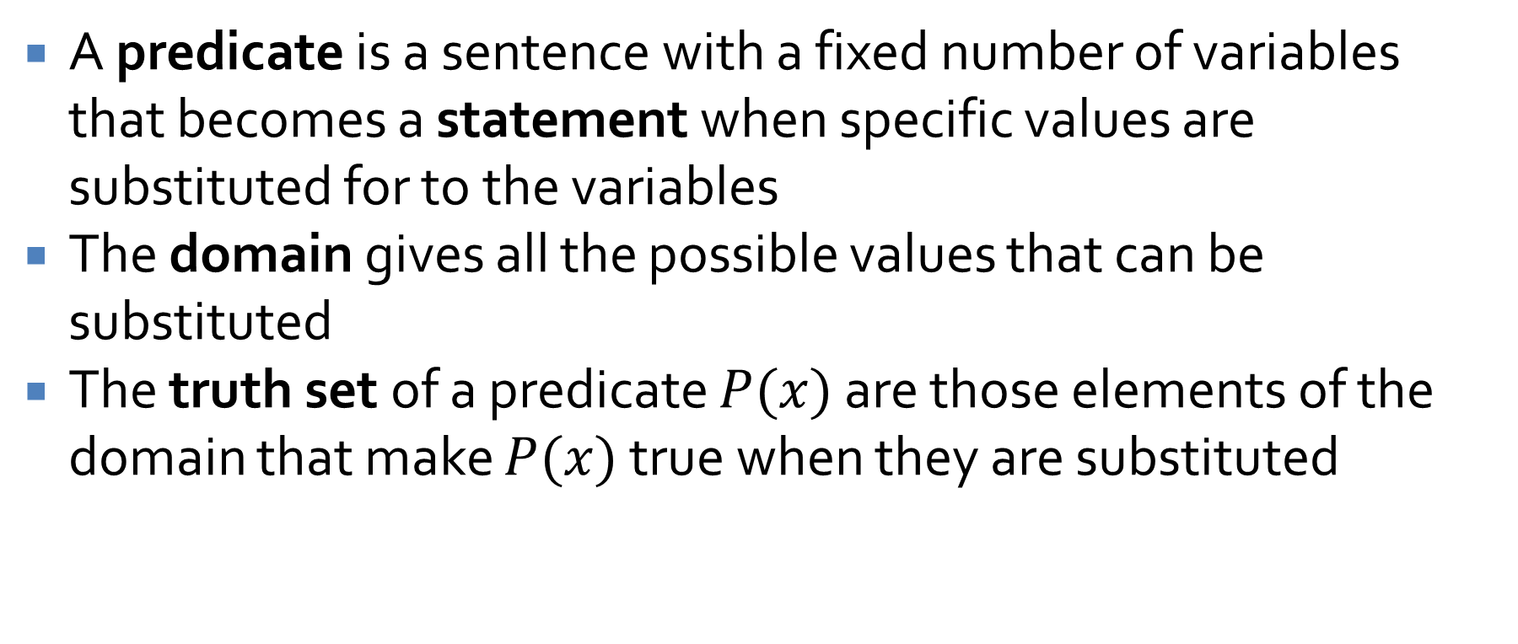
Predicates
A predicate is a sentence with a fixed number of variables that becomes a statement when specific values are substituted for to the variables
The domain gives all the possible values that can be substituted
The truth set of a predicate $P(x)$ are those elements of the domain that make $P(x)$ true when they are substituted

Slide 15
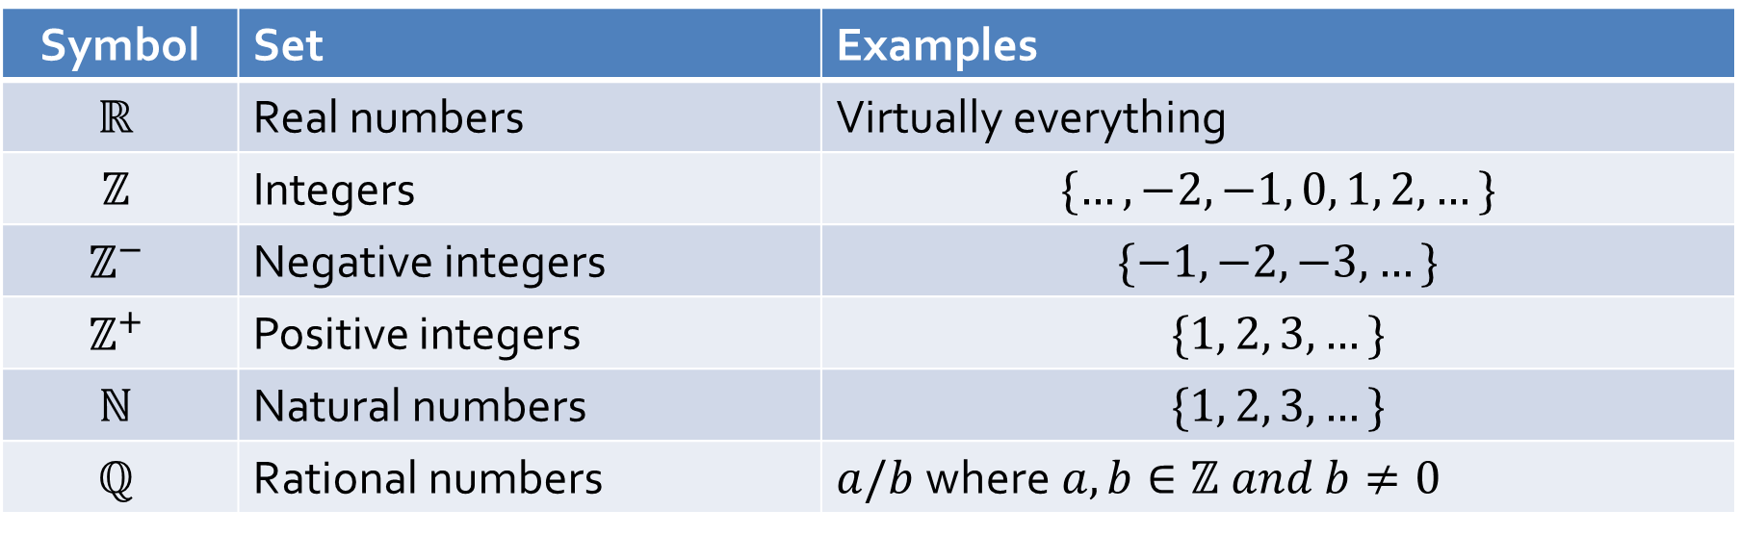

Sets
We will frequently be referring to various sets of numbers in this class
Some typical notation used for these sets:
Some authors use $ℤ^{+}$ to refer to non-negative integers and only $ℕ$ for the natural numbers
Symbol | Set | Examples
$$ℝ$$ | Real numbers | Virtually everything
$$ℤ$$ | Integers | $$\{…, −2, −1, 0, 1, 2,…\}$$
$$ℤ^{−}$$ | Negative integers | $$\{−1, −2, −3, …\}$$
$$ℤ^{+}$$ | Positive integers | $$\{1, 2, 3, …\}$$
$$ℕ$$ | Natural numbers | $$\{1, 2, 3, …\}$$
$$ℚ$$ | Rational numbers | $a/b$where$a,b∈ℤ and b≠0$

Slide 16
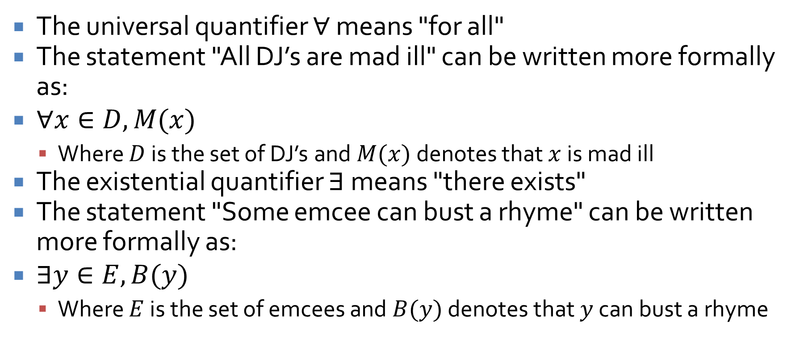
Quantifiers
The universal quantifier $∀$ means "for all"
The statement "All DJ’s are mad ill" can be written more formally as:
$∀x∈D, M(x)$
Where $D$ is the set of DJ’s and $M(x)$ denotes that $x$ is mad ill
The existential quantifier $∃$ means "there exists"
The statement "Some emcee can bust a rhyme" can be written more formally as:
$∃y∈E, B(y)$
Where $E$ is the set of emcees and $B(y)$ denotes that $y$ can bust a rhyme

Slide 17
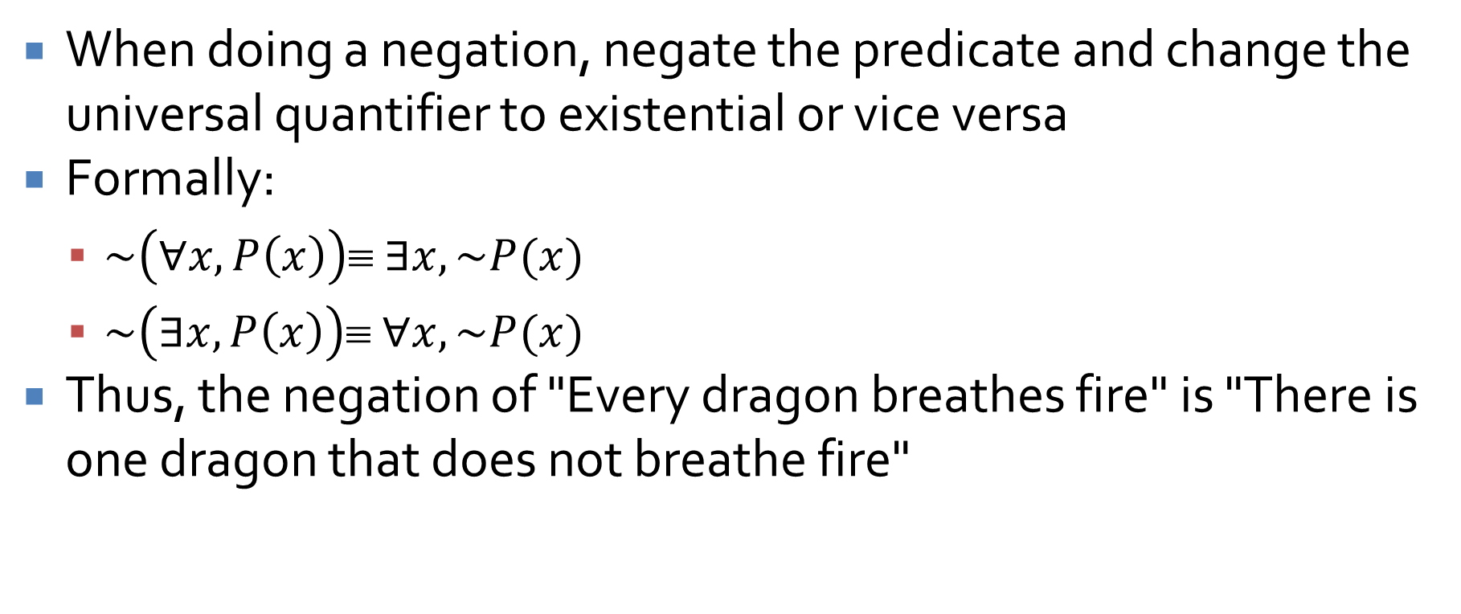
Negating quantified statements
When doing a negation, negate the predicate and change the universal quantifier to existential or vice versa
Formally:
$\sim \left(∀x, P\left(x\right)\right)≡ ∃x, \sim P(x)$
$\sim \left(∃x, P\left(x\right)\right)≡ ∀x, \sim P(x)$
Thus, the negation of "Every dragon breathes fire" is "There is one dragon that does not breathe fire"

Slide 18
Vacuously true
Any statement with a universal quantifier whose domain is the empty set is vacuously true
When we talk about "all things" and there's nothing there, we can say anything we want
"All mythological creatures are real."
Every single one of the (of which there are none) is real

Slide 19
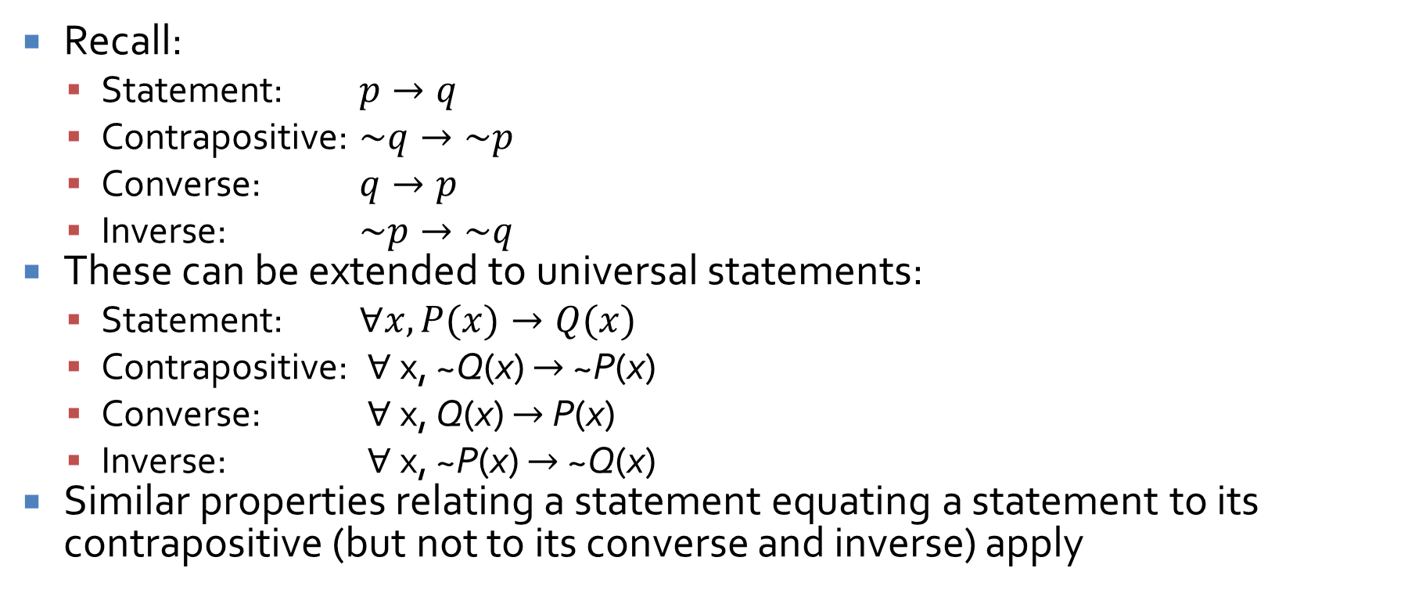
Conditionals
Recall:
Statement: $p→q$
Contrapositive: $\sim q→\sim p$
Converse: $q→p$
Inverse: $\sim p→\sim q$
These can be extended to universal statements:
Statement: $∀x, P(x)→Q(x)$
Contrapositive: $∀$x, ~Q(x) $→$ ~P(x)
Converse: $∀$x, Q(x) $→$ P(x)
Inverse: $∀$x, ~P(x) $→$ ~Q(x)
Similar properties relating a statement equating a statement to its contrapositive (but not to its converse and inverse) apply

Slide 20
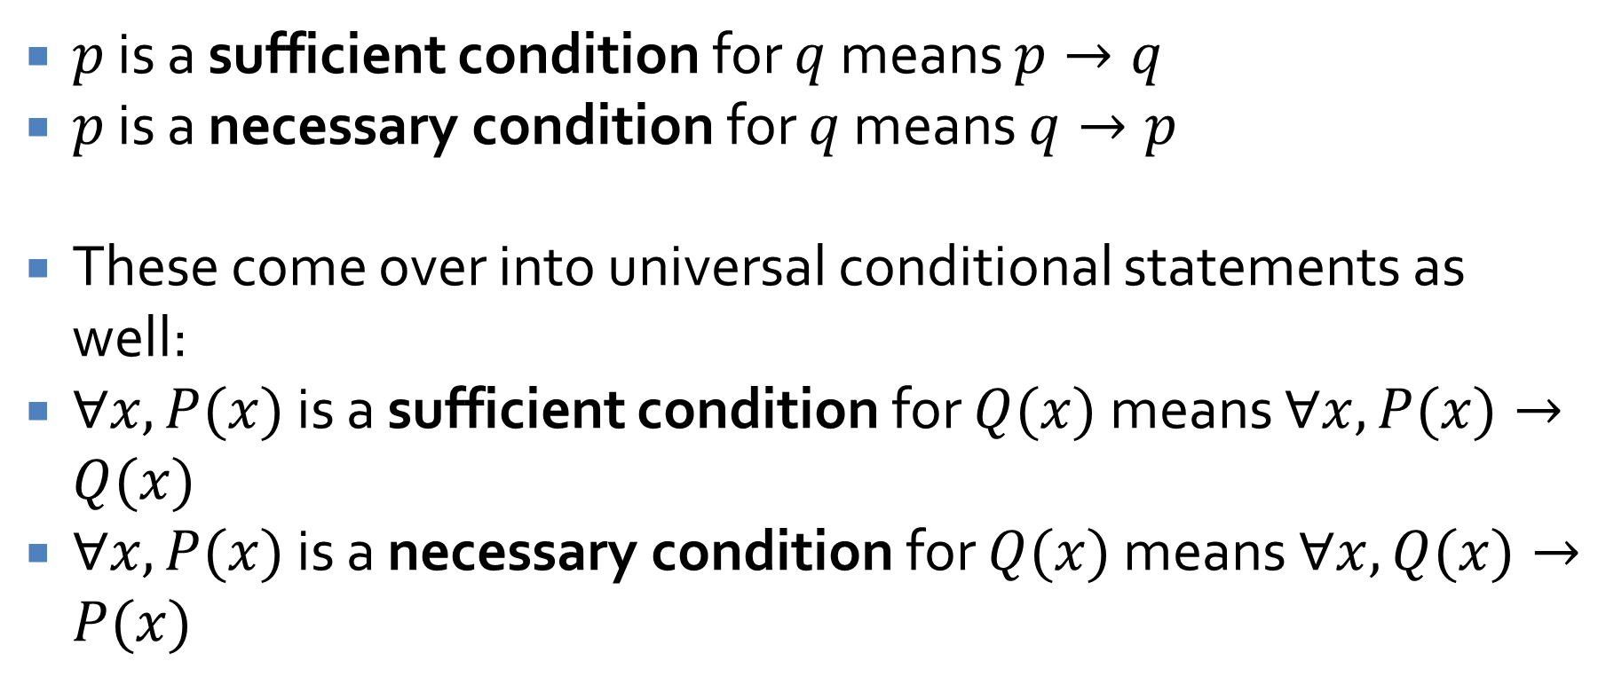
Necessary and sufficient
$p$ is a sufficient condition for $q$ means $p→q$
$p$ is a necessary condition for $q$ means $q→p$
These come over into universal conditional statements as well:
$∀x, P(x)$ is a sufficient condition for $Q(x)$ means $∀x, P(x)→Q(x)$
$∀x, P(x)$ is a necessary condition for $Q(x)$ means $∀x, Q(x)→P(x)$

Slide 21
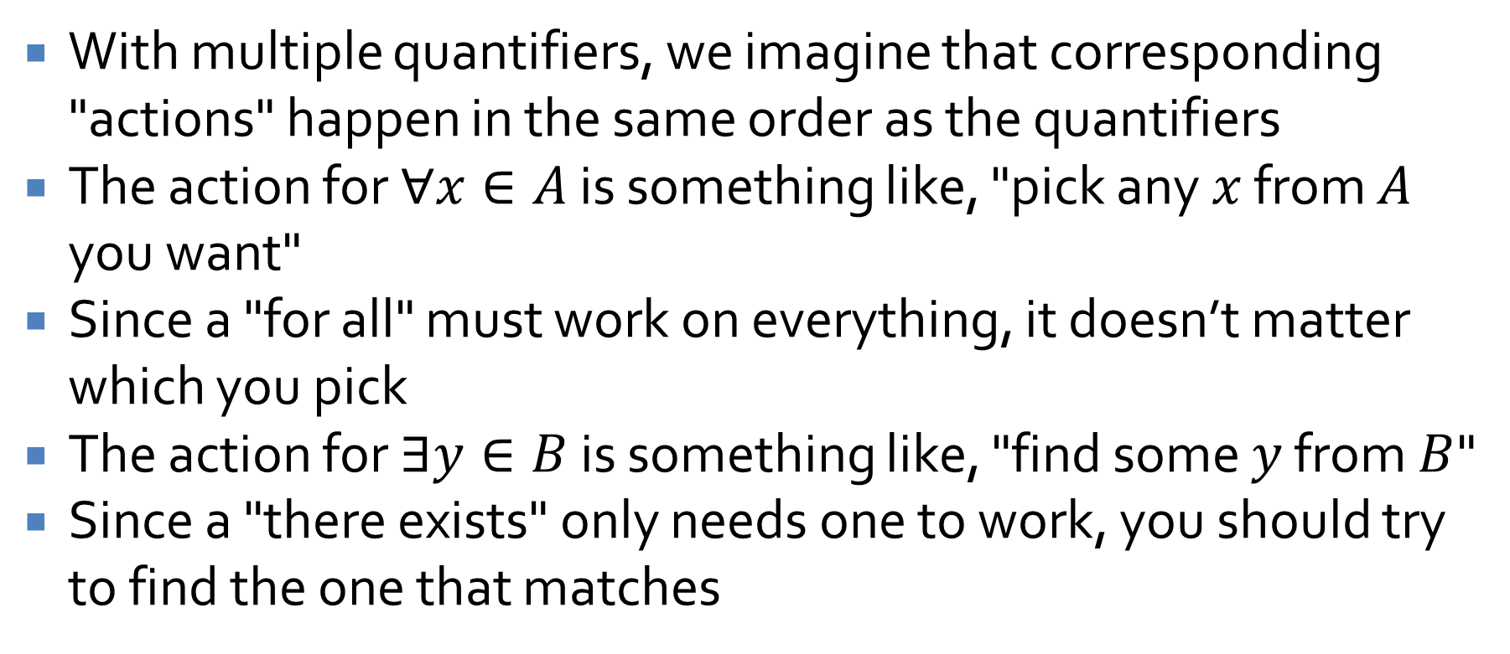
Multiple quantifiers
With multiple quantifiers, we imagine that corresponding "actions" happen in the same order as the quantifiers
The action for $∀x∈A$ is something like, "pick any $x$ from $A$ you want"
Since a "for all" must work on everything, it doesn’t matter which you pick
The action for $∃y∈B$ is something like, "find some $y$ from $B$"
Since a "there exists" only needs one to work, you should try to find the one that matches

Slide 22
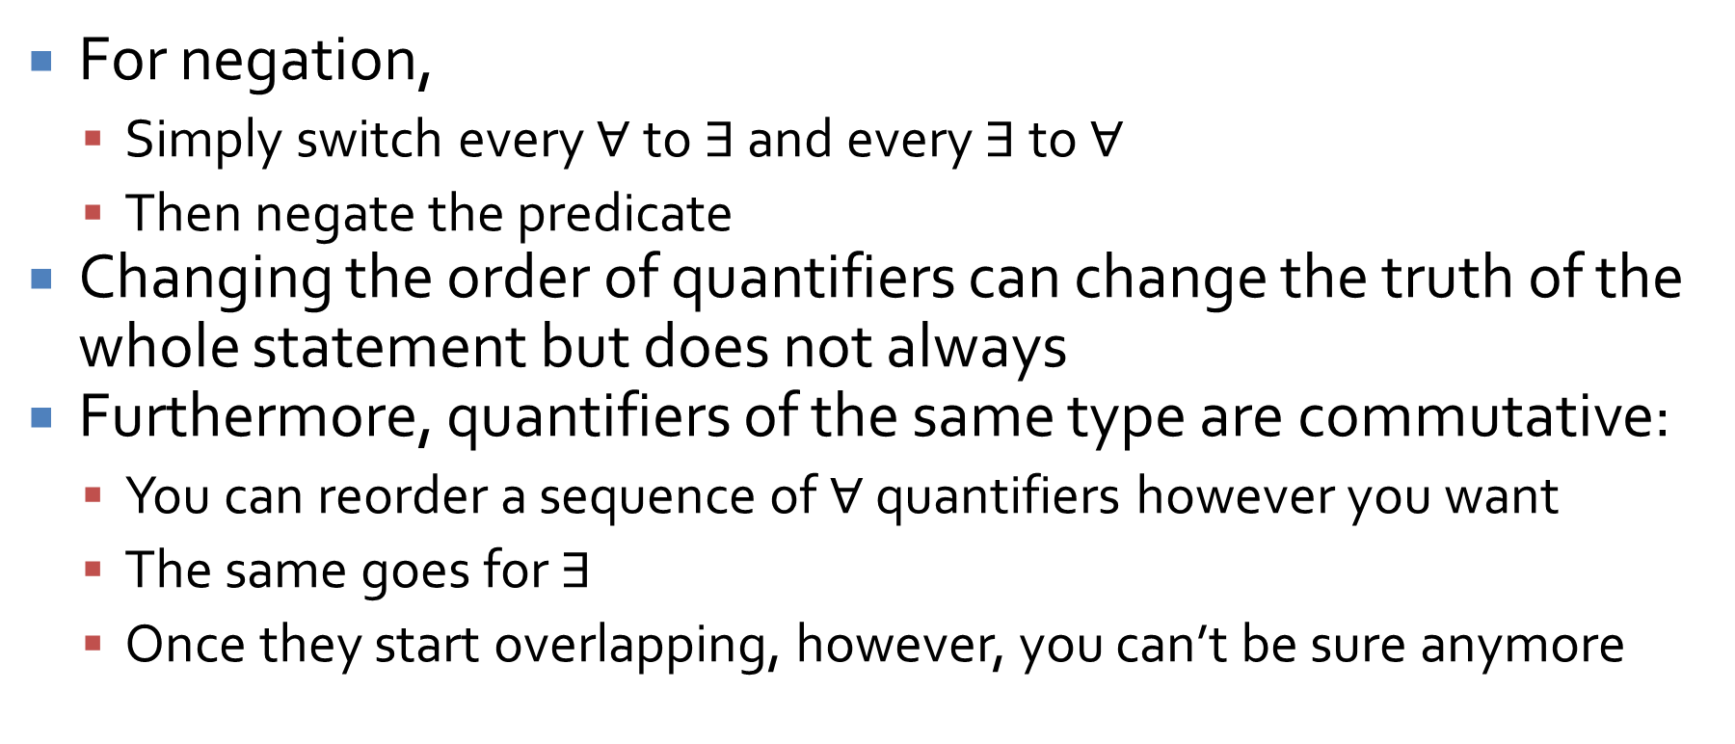
Negating or changing multiple quantifiers
For negation,
Simply switch every $∀$ to $∃$ and every $∃$ to $∀$
Then negate the predicate
Changing the order of quantifiers can change the truth of the whole statement but does not always
Furthermore, quantifiers of the same type are commutative:
You can reorder a sequence of $∀$ quantifiers however you want
The same goes for $∃$
Once they start overlapping, however, you can’t be sure anymore

Slide 23
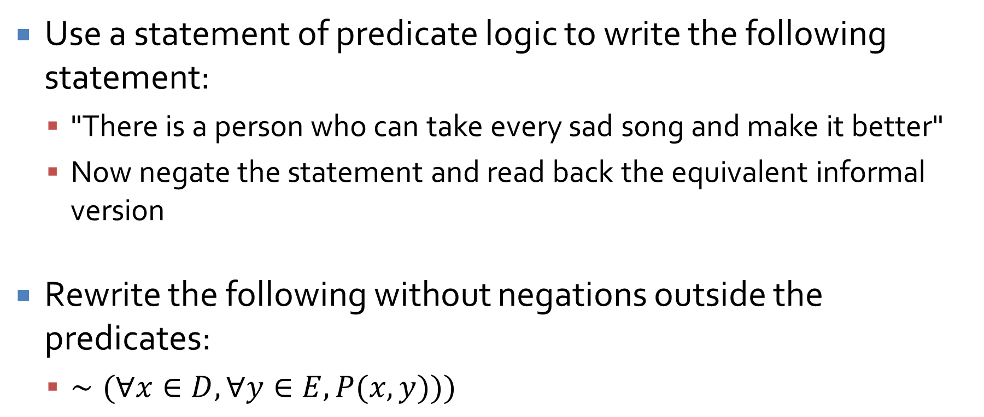
Practice
Use a statement of predicate logic to write the following statement:
"There is a person who can take every sad song and make it better"
Now negate the statement and read back the equivalent informal version
Rewrite the following without negations outside the predicates:
$∼(∀x∈D,∀y∈E, P(x, y)))$

Slide 24
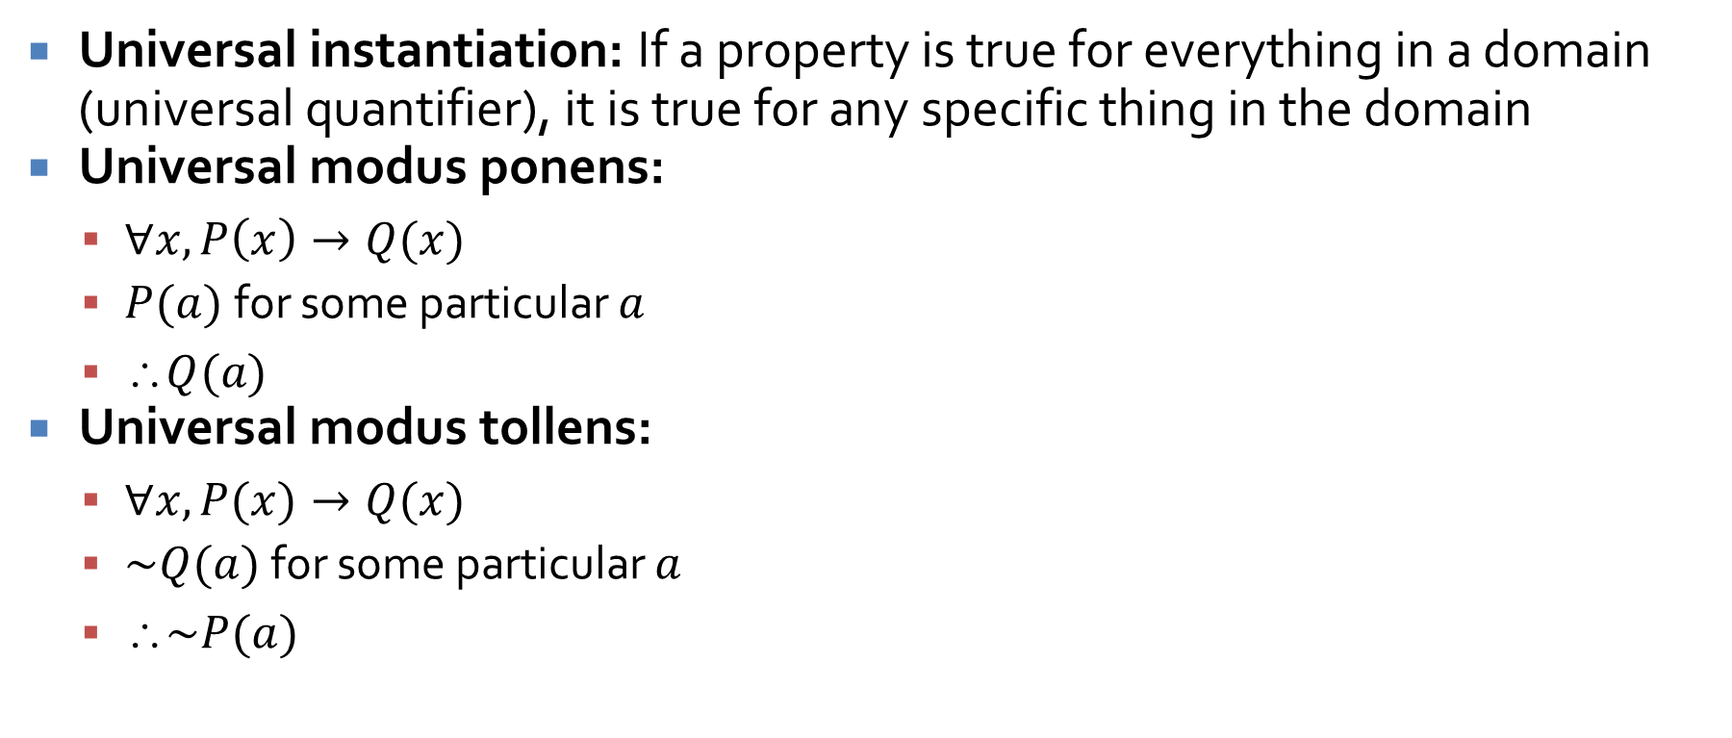
Quantification in arguments
Universal instantiation: If a property is true for everything in a domain (universal quantifier), it is true for any specific thing in the domain
Universal modus ponens:
$∀x, P\left(x\right)→Q(x)$
$P(a)$for some particular $a$
$Q(a)$
Universal modus tollens:
$∀x, P(x)→Q(x)$
$\sim Q(a)$ for some particular $a$
$\sim P(a)$

Slide 25
Proofs Review

Slide 26
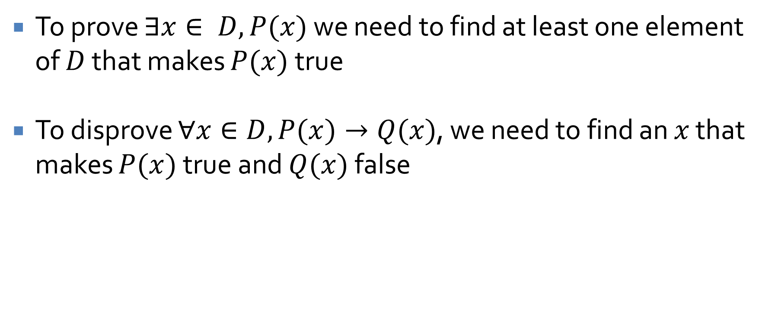
Proving existential statements and disproving universal ones
To prove $∃x∈ D, P(x)$ we need to find at least one element of $D$ that makes $P(x)$ true
To disprove $∀x∈D, P(x)→Q(x)$, we need to find an $x$ that makes $P(x)$true and $Q(x)$ false

Slide 27
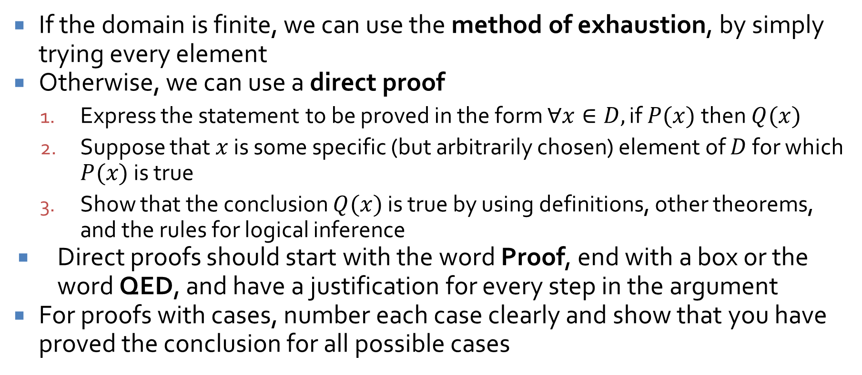
Proving universal statements
If the domain is finite, we can use the method of exhaustion, by simply trying every element
Otherwise, we can use a direct proof
Express the statement to be proved in the form $∀x∈D,$if $P(x)$then $Q(x)$
Suppose that $x$ is some specific (but arbitrarily chosen) element of $D$ for which $P(x)$ is true
Show that the conclusion $Q(x)$ is true by using definitions, other theorems, and the rules for logical inference
Direct proofs should start with the word Proof, end with a box or the word QED, and have a justification for every step in the argument
For proofs with cases, number each case clearly and show that you have proved the conclusion for all possible cases

Slide 28
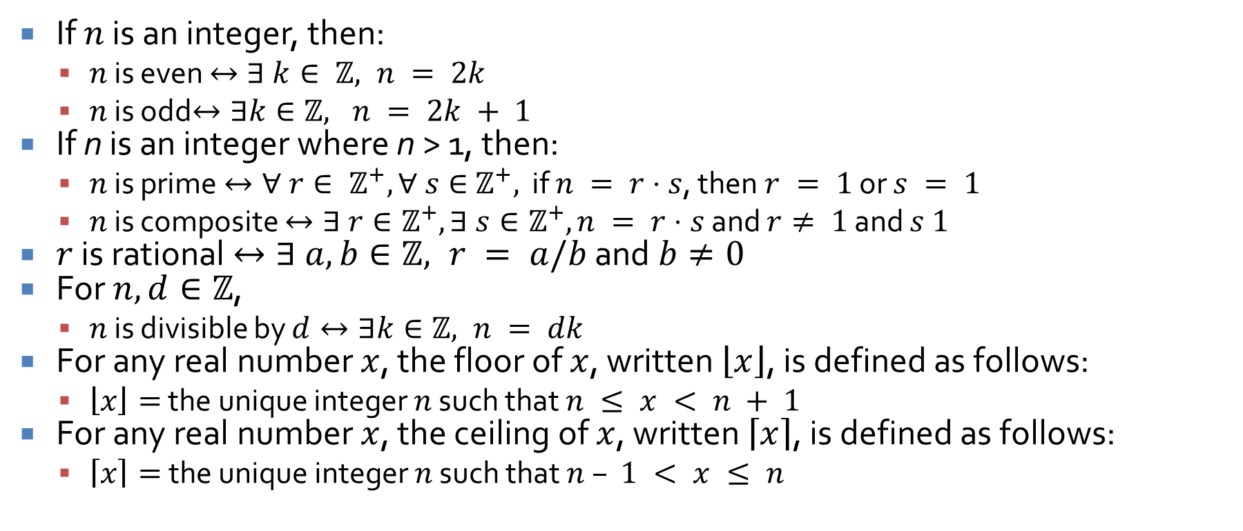
Definitions
If $n$ is an integer, then:
$n$ is even $↔∃ k∈ ℤ, n = 2k$
$n$ is odd$↔∃k∈ℤ, n = 2k + 1$
If n is an integer where n > 1, then:
$n$ is prime $↔∀ r∈ ℤ^{+}, ∀ s∈{ ℤ}^{+},$ if $n = r⋅s$, then $r = 1$ or $s = 1$
$n$ is composite $↔∃ r∈ℤ^{+},∃ s∈ℤ^{+}, n = r⋅s$ and $r≠ 1$ and $s 1$
$r$ is rational $↔∃ a, b∈ℤ, r = a/b$ and $b≠0$
For $n, d∈ℤ$,
$n$ is divisible by $d↔∃k∈ℤ, n = dk$
For any real number $x$, the floor of $x$, written $\left\lfloor x\right\rfloor$, is defined as follows:
$\left\lfloor x\right\rfloor =$ the unique integer $n$ such that $n ≤ x < n + 1$
For any real number $x$, the ceiling of $x$, written $\left\lceil x\right\rceil$, is defined as follows:
$\left\lceil x\right\rceil =$the unique integer $n$ such that $n – 1 < x ≤ n$

Slide 29
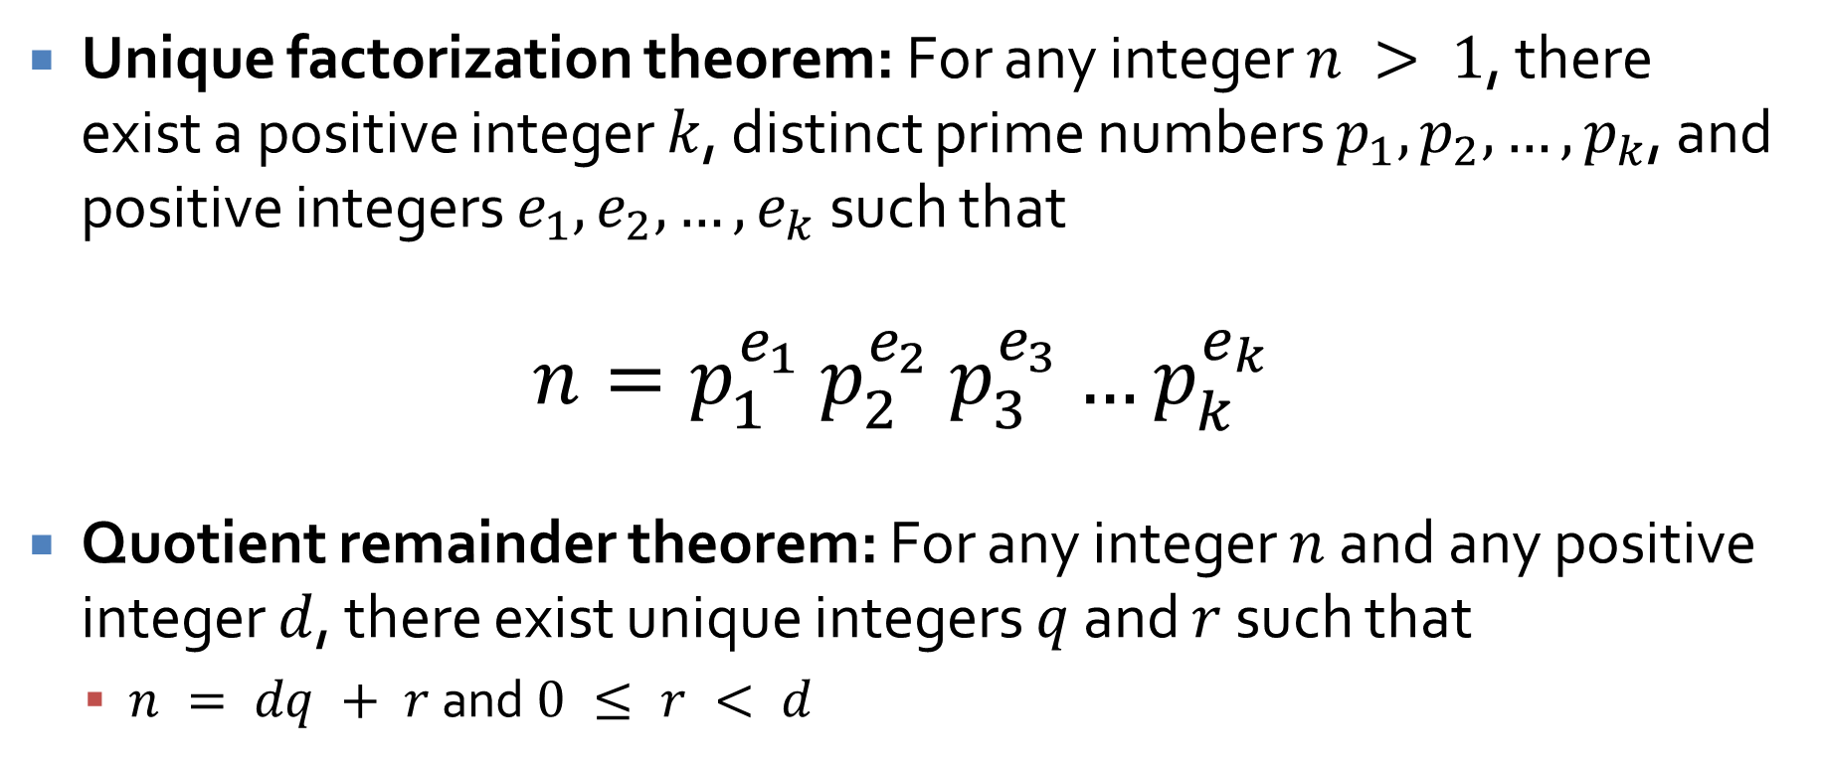
Theorems
Unique factorization theorem: For any integer $n > 1$, there exist a positive integer $k$, distinct prime numbers $p_{1}, p_{2}, …, p_{k}$, and positive integers $e_{1}, e_{2}, …, e_{k}$ such that
$n=p_{1}^{e_{1}}$ $p_{2}^{e_{2}}$ $p_{3}^{e_{3}}…p_{k}^{e_{k}}$
Quotient remainder theorem: For any integer $n$ and any positive integer $d$, there exist unique integers $q$ and $r$ such that
$n = dq + r$ and $0 ≤ r < d$

Slide 30
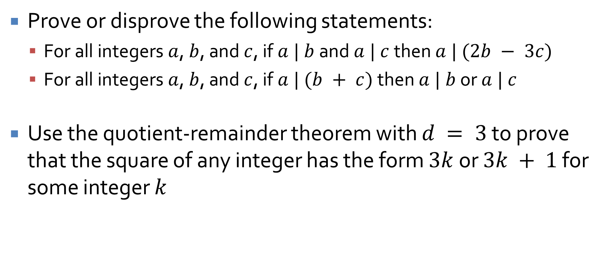
Practice
Prove or disprove the following statements:
For all integers $a$, $b$, and $c$, if $a | b$ and $a | c$ then $a | (2b − 3c)$
For all integers $a$, $b$, and $c$, if $a | (b + c)$ then $a | b$ or $a | c$
Use the quotient-remainder theorem with $d = 3$ to prove that the square of any integer has the form $3k$ or $3k + 1$ for some integer $k$

Slide 31
Indirect Proofs

Slide 32
Proof by contradiction
In a proof by contradiction, you begin by assuming the negation of the conclusion
Then, you show that doing so leads to a logical impossibility
Thus, the assumption must be false and the conclusion true

Slide 33
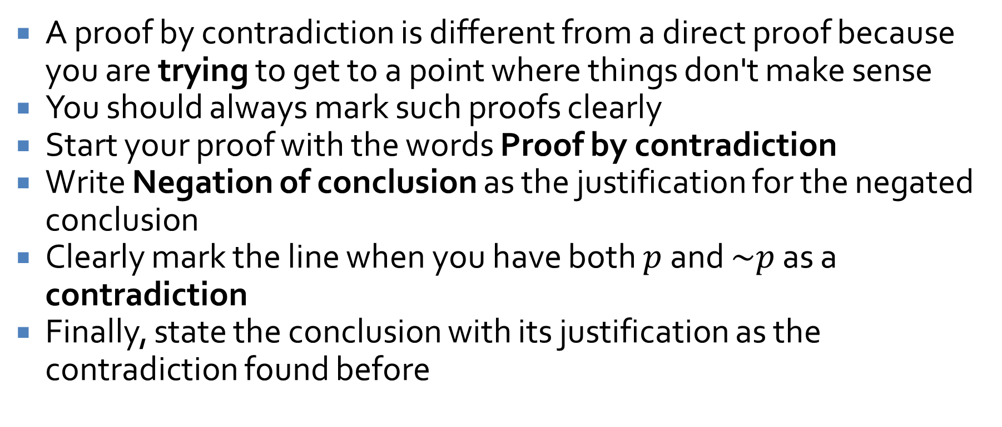
Contradiction formatting
A proof by contradiction is different from a direct proof because you are trying to get to a point where things don't make sense
You should always mark such proofs clearly
Start your proof with the words Proof by contradiction
Write Negation of conclusion as the justification for the negated conclusion
Clearly mark the line when you have both $p$ and $\sim p$ as a contradiction
Finally, state the conclusion with its justification as the contradiction found before

Slide 34

Practice
Use a proof by contradiction to prove the following:
For all prime numbers $a$, $b$, and $c$, $a^{2} + b^{2}≠c^{2}$

Slide 35
Sequences and Induction

Slide 36
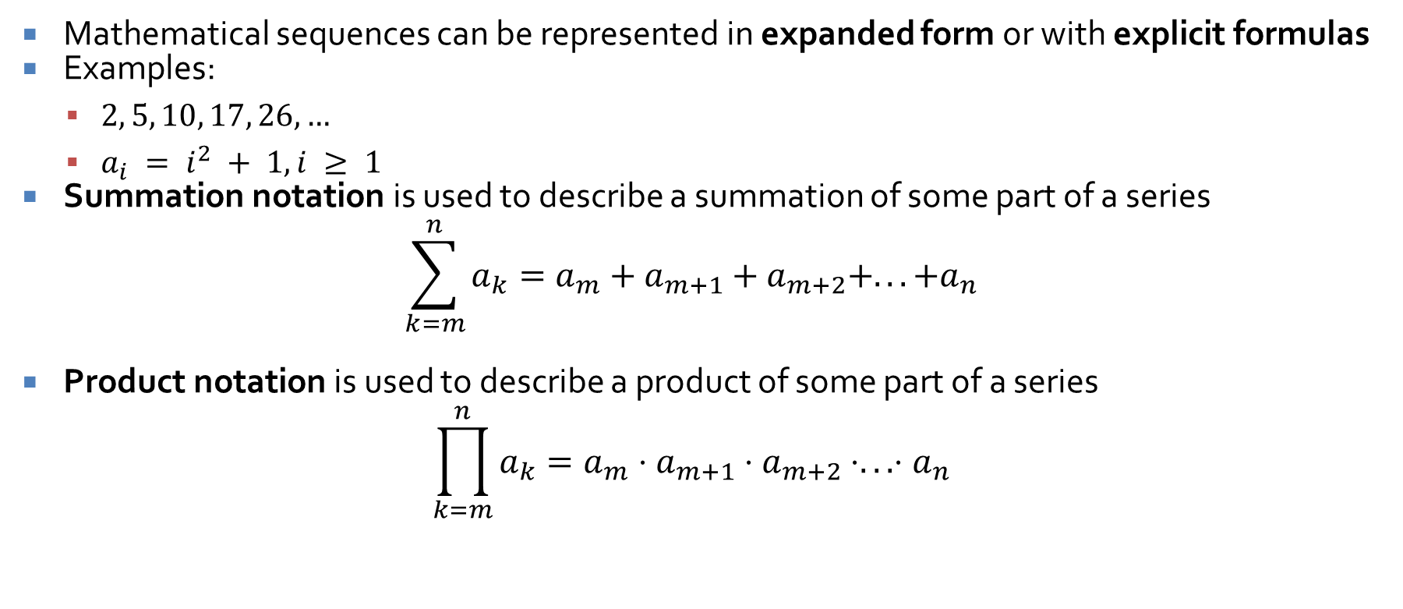
Sequences
Mathematical sequences can be represented in expanded form or with explicit formulas
Examples:
$2, 5, 10, 17, 26, …$
$a_{i} = i^{2} + 1, i ≥ 1$
Summation notation is used to describe a summation of some part of a series
$$\sum_{k=m}^{n}{a_{k}}=a_{m}+a_{m+1}+a_{m+2}+...+a_{n}$$
Product notation is used to describe a product of some part of a series
$$\prod_{k=m}^{n}{a_{k}}=a_{m}⋅a_{m+1}⋅a_{m+2}⋅...⋅a_{n}$$

Slide 37
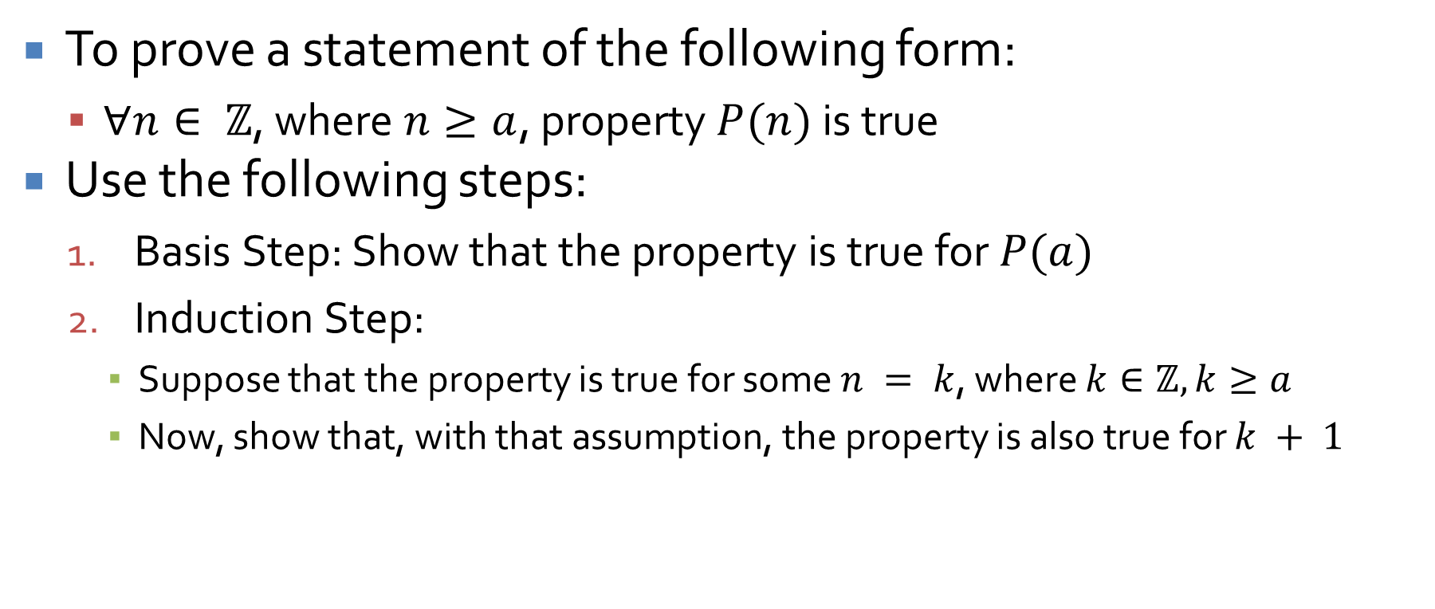
Proof by mathematical induction
To prove a statement of the following form:
$∀n∈ ℤ$, where $n≥a$, property $P(n)$ is true
Use the following steps:
Basis Step: Show that the property is true for $P(a)$
Induction Step:
Suppose that the property is true for some $n = k$, where $k∈ℤ, k≥a$
Now, show that, with that assumption, the property is also true for $k + 1$

Slide 38
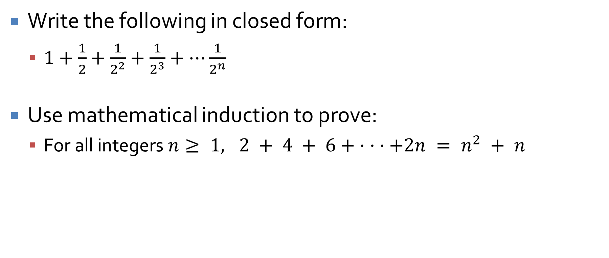
Practice
Write the following in closed form:
$1+\frac{1}{2}+\frac{1}{2^{2}}+\frac{1}{2^{3}}+…\frac{1}{2^{n}}$
Use mathematical induction to prove:
For all integers $n≥ 1, 2 + 4 + 6+ · · ·+2n = n^{2} + n$

Slide 39
Recursion
Using recursive definitions to generate sequences
Writing a recursive definition based on a sequence
Using mathematical induction to show that a recursive definition and an explicit definition are equivalent

Slide 40
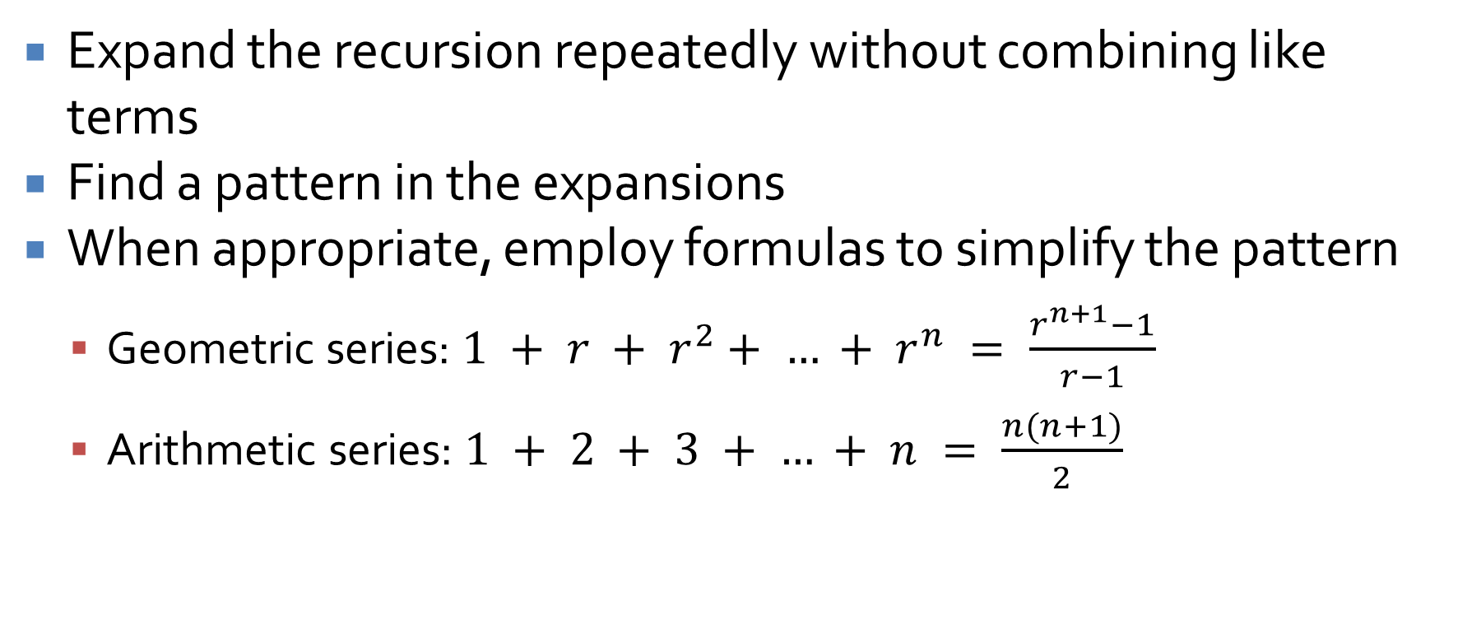
Solving recursion by iteration
Expand the recursion repeatedly without combining like terms
Find a pattern in the expansions
When appropriate, employ formulas to simplify the pattern
Geometric series: $1 + r + r^{2}+ … + r^{n} = \frac{r^{n+1}−1}{r−1}$
Arithmetic series: $1 + 2 + 3 + … + n = \frac{n(n+1)}{2}$

Slide 41
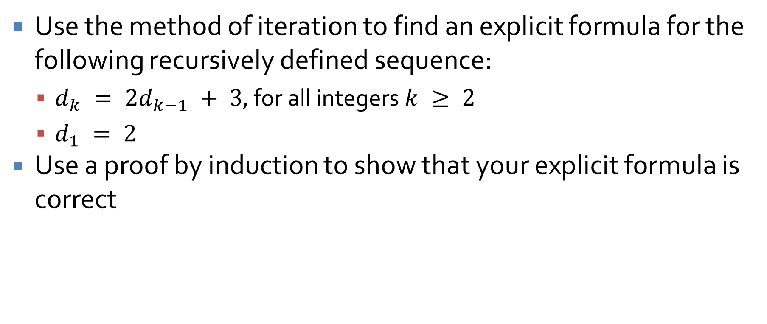
Practice
Use the method of iteration to find an explicit formula for the following recursively defined sequence:
$d_{k} = 2d_{k−1} + 3,$for all integers$k ≥ 2$
$d_{1} = 2$
Use a proof by induction to show that your explicit formula is correct

Slide 42
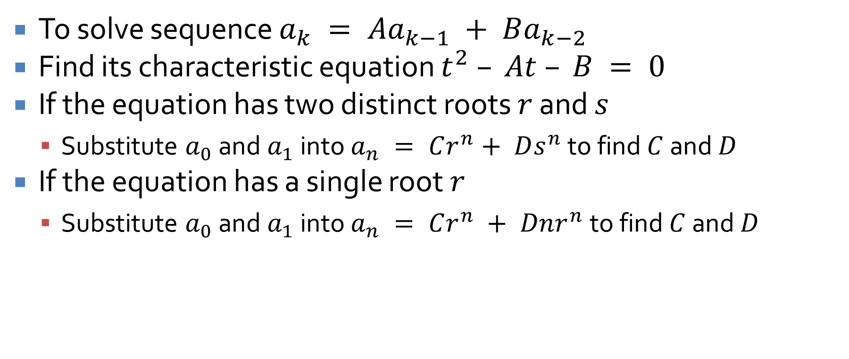
Solving second order linear homogeneoous recurrence relations with constant coefficients
To solve sequence $a_{k} = Aa_{k−1} + Ba_{k−2}$
Find its characteristic equation $t^{2} – At – B = 0$
If the equation has two distinct roots $r$ and $s$
Substitute $a_{0}$ and $a_{1}$ into $a_{n} = Cr^{n}+ Ds^{n}$ to find $C$ and $D$
If the equation has a single root $r$
Substitute $a_{0}$ and $a_{1}$ into $a_{n} = Cr^{n} + Dnr^{n}$ to find $C$ and $D$

Slide 43

Practice
Find an explicit formula for the following:
$r_{k} = 2r_{k−1} − r_{k−2}$, for all integers $k≥2$
$r_{0} = 1$
$r_{1} = 4$

Slide 44
Upcoming

Slide 45
Next time…
Review of second third of the course

Slide 46
Reminders
Keep working on Assignment 6
Due next Wednesday

